Slide 1
Using HomeBank
Alex Cristia
LSCP, Département d'études cognitives,
ENS, EHESS, CNRS, PSL Research University

Slide 2
Homebank components
Data repository
http://homebank.talkbank.org/
Software repository
https://github.com/HomeBankCode

Slide 3
Data repository
Notes:
Notice it’s the same format as all the other TalkBank components

Slide 4
Data repository
NB useful information for using the HomeBank system

Slide 5
Data repository
DATA

Slide 6
Online browser & public data
VanDam Public:
53 x 2-4 x 5 mins slices from Hearing Impaired kids
~ 13 HOURS OF TRANSCRIBED RECORDINGS
60205 tokens, 3951 types
Data repository
TalkBank Screencasts
Listening on the browser
Searches on the browser
More powerful CLAN searches
Notes:
I want to say:

Slide 7
What’s up there already
vanDam: Public, details above
Password-protected, daylong recordings:
Bergelson: N = 49; 6m-7m
VanDam: N = 59 hearing-impaired, N = 35 normal-hearing; 0-90m
LeNormand (Lyon): N = 16; 3-21m; French
McDivitt: N = 25; 2 to 20m; born to young/teen moms
Warlaumont: N = 18; 3-6m; some Spanish
Soderstrom: N = 8; 12-38m; various child care arrangements
Data repository
Notes:
http://homebank.talkbank.org/access/
Corpus
Recordings
Description
Access
Contributor
Bergelson Seedlings
49
Study of exposure to object words
members
Elika Bergelson
Cougar
59 HI, 35 NH
English
members
Mark VanDam
McDivitt
25
Children born to adolescent and adult mothers
members
Karmen McDivitt
Lyon
16
French
members
Marie-Thérèse LeNormand
VanDam Public
53
159 5-minute transcribed segments from 53 daylong recordings
public
Mark VanDam
Warlaumont
18
Longitudinal study of children learning English and Spanish
members
Anne Warlaumont
Winnipeg
8
Comparison across different child care settings
members
Melanie Soderstrom

Slide 8
Accessing non-public data: Membership
Email 4homebank@gmail.com:
Name, title, university, research area
Address, email, phone
Have a brief phone call with a HomeBank staff member to review key data confidentiality & proper use considerations:
Do’s: cite producers properly; respect requests of constrained re-use; keep track of copies made, and delete them if asked to
Don’t’s: share password-protected data with outsiders except supervisees
Sign data agreement recapping the same points
Data repository
Notes:
HomeBank includes both an open component for which no password or special membership is needed and a restricted component that is password protected. The restricted component is only open to members and people working under their direct supervision. Members must be university faculty or senior researchers at other institutions. Students seeking access to HomeBank data should do so under the direction of their faculty advisors.
To apply for membership in HomeBank, please send email to 4homebank@gmail.com. Include your
name
title
university
address
email
phone
research area
We will reply to your request first through email and then through a brief phone call to review data confidentiality considerations.
All HomeBank members must agree to these terms.

Slide 9
Speedy membership - today!
Have a brief chat call with a HomeBank staff member at the speedy registration desk
Sign data agreement
Data repository

Slide 10
Data repository
TOOLS

Slide 11
What’s up there already
Languages
Praat, perl, matlab, R, python...: All orientations are welcome!
Goals
Calculate frequency of key events (speaker segments, conversations…)
Get acoustics of some key segments (e.g., all female adult vocalizations, classified by whether they are next to a child vocalization or not → Parentese)
Plot distribution of speaker & adult word counts as a function of time
Interface to select and play recording skipping silences
...
Tools repository

Slide 12
Using github
Through the browser interface
Peruse previous contributions
Download code of your choice
Run it in your favorite program
Through the terminal or their application:
Just pull and edit
Take advantage of the opportunity to get into github
Your edits are tracked as such
Hassle-free versioning
If you have a cool edit, submit a “pull request”
Including mark-down instructions will increase the chances your code is re-used & facilitate other people’s lives → karma points & citations!
Tools repository

Slide 13
Homebank components
Data repository
http://homebank.talkbank.org/
Software repository
https://github.com/HomeBankCode
A hidden component: The DARCLE community

Slide 14
DAylong Recordings of Children’s Language Environment (DARCLE)
Who we are
Currently 52 members from US, UK, Netherlands, Sweden…
Most are “producers” (some, including me, are “users” or “developers”)
Many are students or young researchers
What we do
Mailing list
A range of community projects
Meet 1x/month for progress reports
Community

Slide 15
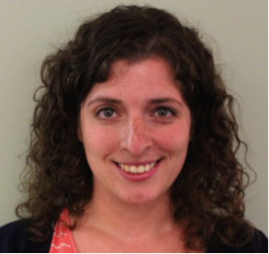
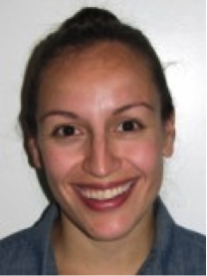
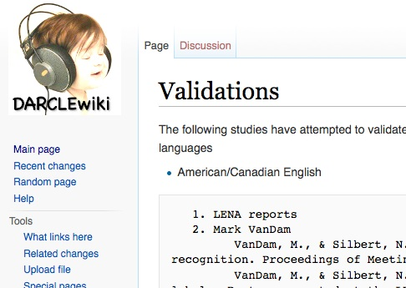
DARCLE: Ongoing projects & activities
Pre-PI discussion group
Child-Directed Speech classifier
Community
Notes:
Gina Pretzer wrote this blurb about Pre-PI DARCLE:
“Pre-PI DARCLE is an international group of students and post-docs using the LENA System in their research. Our 8 members represent four countries (USA, Canada, UK, and Norway), and we are still growing. We hold monthly conference calls where we discuss recent relevant literature and provide each other with feedback and support in our work. Recently, we have discussed issues such as data collection, acquiring consent, and coding/transcribing LENA recordings. We also liase with the larger DARCLE community and discuss how their work might relate to our own. To join, please contact Hillary at hillary.ganek@mail.utoronto.ca.”

Slide 16
Thank you!
http://homebank.talkbank.org/
https://github.com/HomeBankCode
www.darcle.org

Slide 17
Teach yourself section

Slide 18
Teach yourself:
Download data
(point & click)

Slide 19
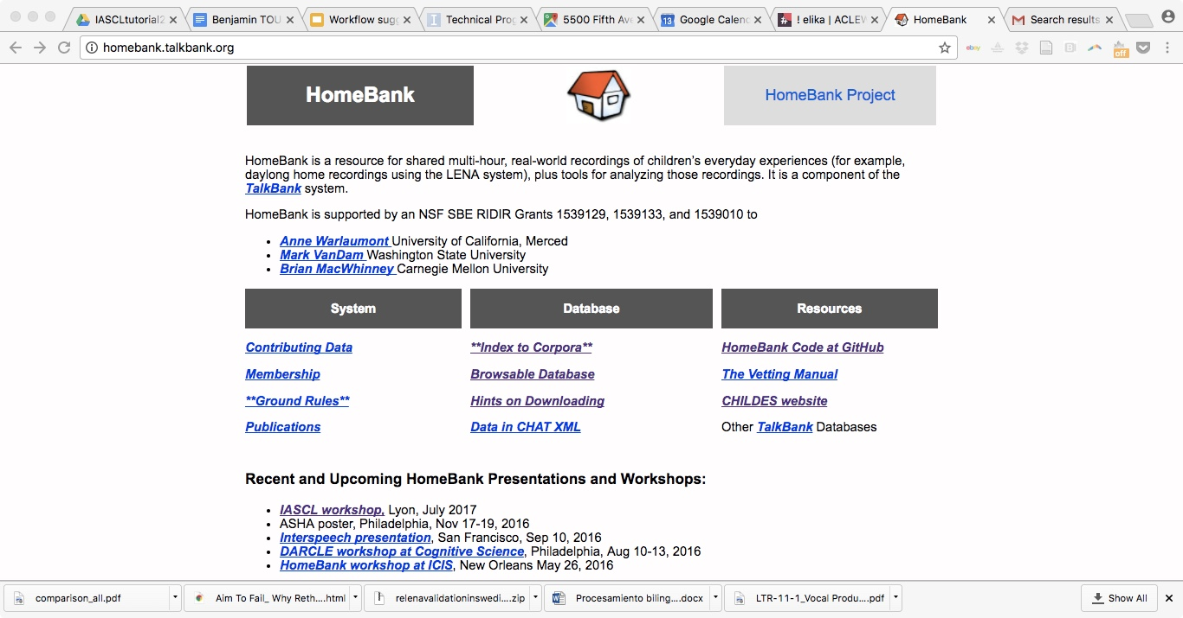

Slide 20
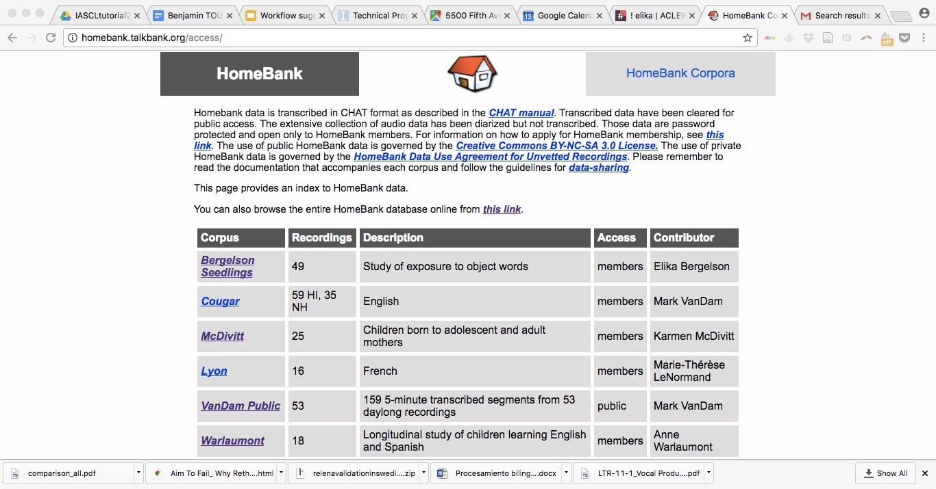

Slide 21
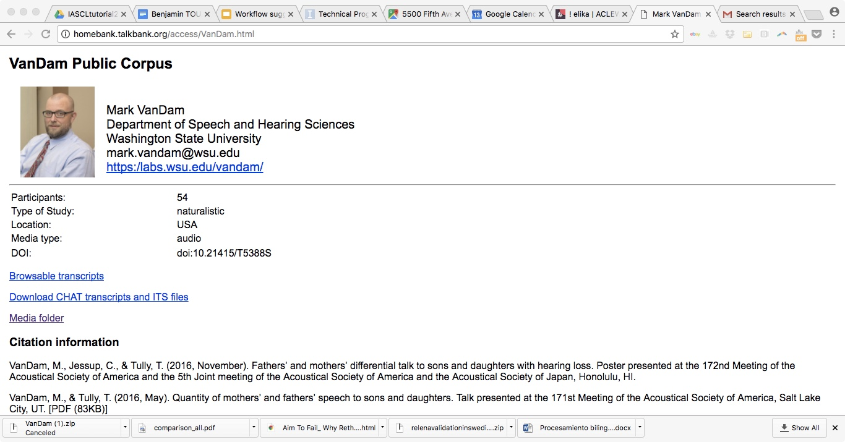

Slide 22
Teach yourself:
Download tools
(point & click)

Slide 24
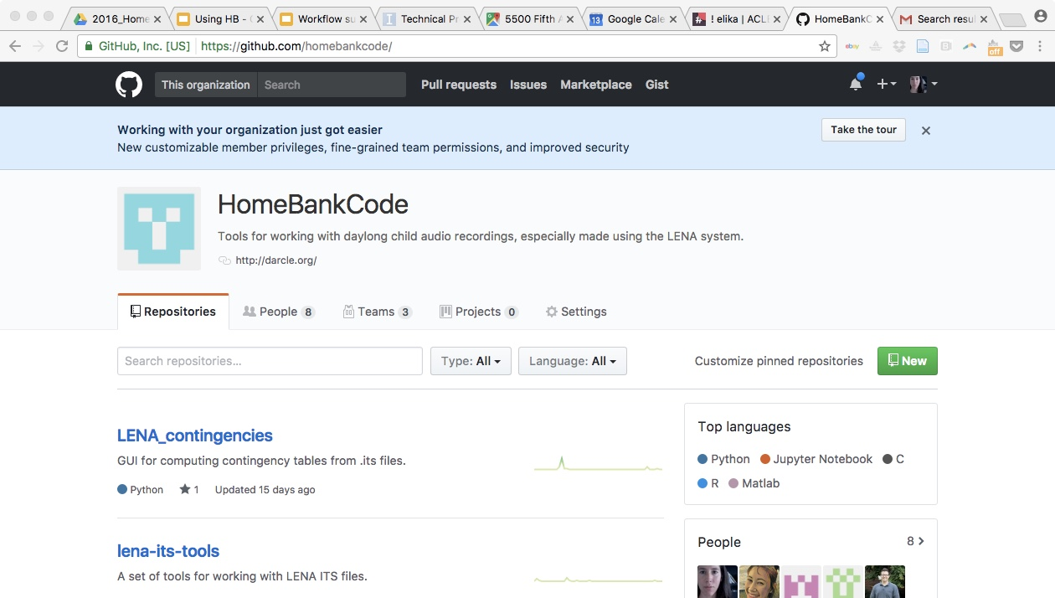
This is the HomeBankCode landing page
For instance, click on this one
Each of these folders contains code built by one of us

Slide 25
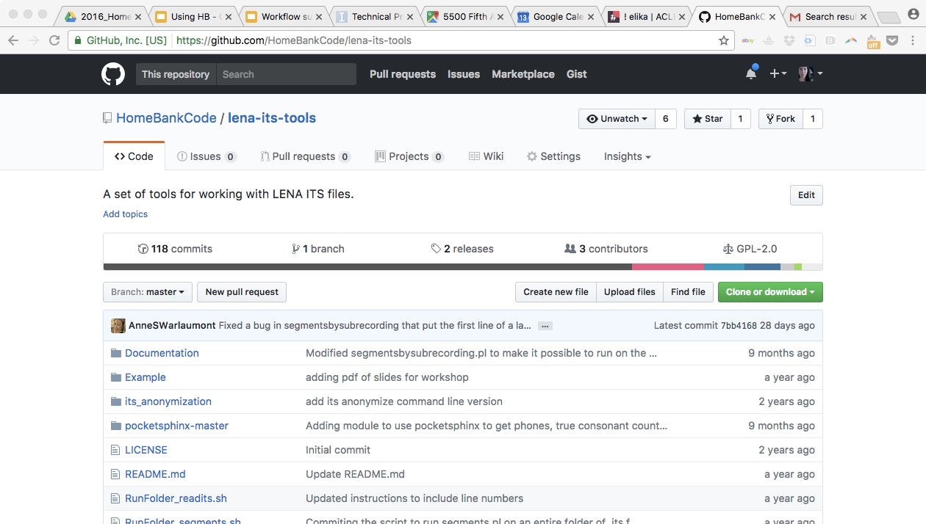
You can get the whole folder by clicking here
Or you can scroll down to see what is in the folder and the readme (see next slides)

Slide 26
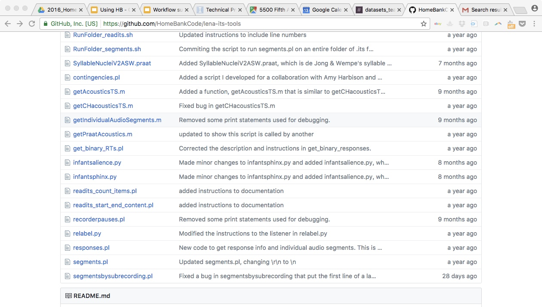
You can also inspect & download a single file by clicking on it
Keep scrolling down to see what is in the folder and the readme (see next slide)

Slide 27
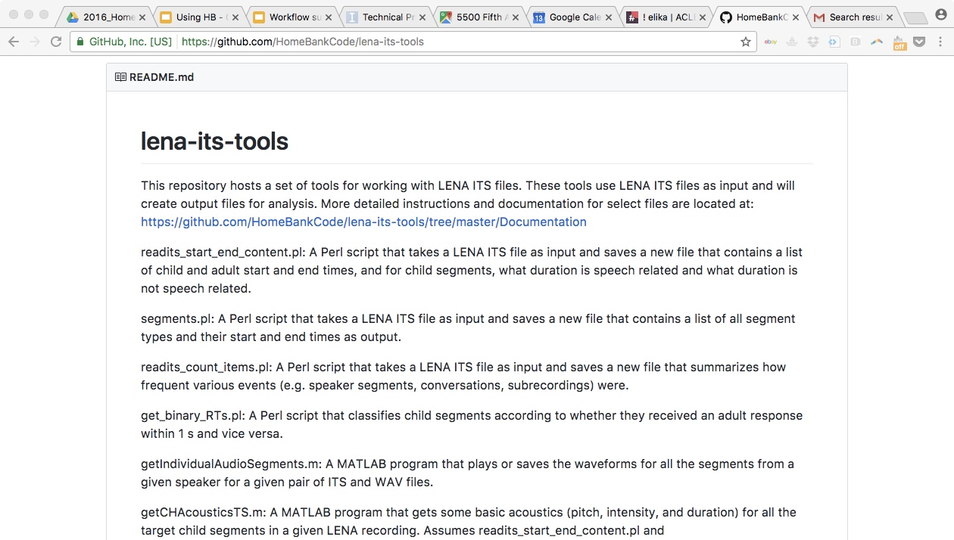
If you scrolled down enough, you found the readme, which describes each script in this folder

Slide 28
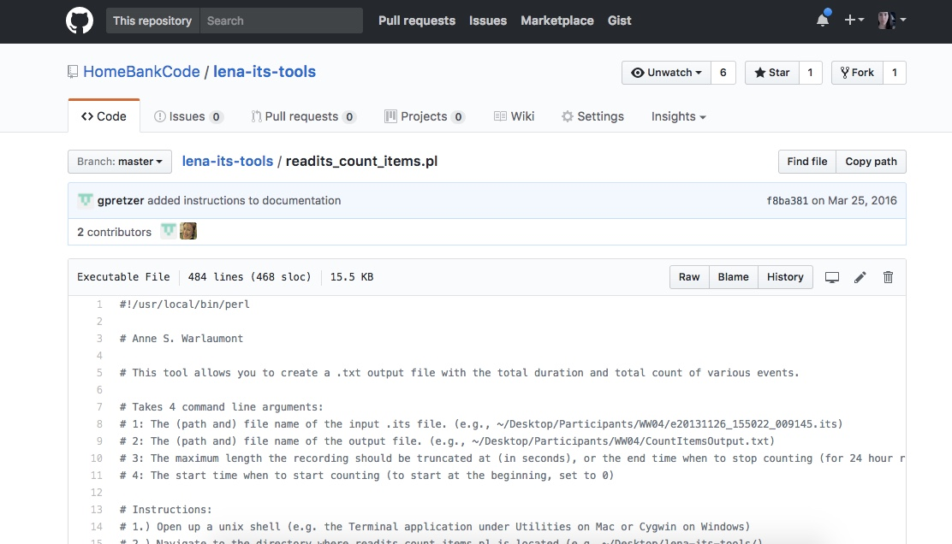
You can get save this as a file by clicking “Raw” then Ctrl+S (or apple+S, depending on your OS)
If you clicked on the readits_count_items.pl, you’ll see this script

Slide 29
Teach yourself: readits_count_items.pl
Thanks to Gina Pretzer & Anne Warlaumont
and many other useful scripts!

