Slide 1
Workflow suggestions
The team

Slide 2
Overview
Visualizing the workflow
Choosing your hardware
Choosing your software for human annotation
Routines for automated analyses
Data collection planning & sampling issues
A forward-looking annotation proposal

Slide 3
$/time for human labeling?
Expertise for automatic labeling?
LENA recorder & software?
No
No
No
Yes
Yes
Yes
For “free”:
Diarization into broad speaker classes
Estimation of adult word counts
Quantity of child “linguistic” versus “non-linguistic” sounds
These are not 100% correct!
Usual annotation times apply:
3-7 x playback time for diarization into broad speaker classes
7-20 x playback time for “deeper” annotation
You’ll still need some annotations to evaluate your system
This problem is hard!
All can be augmented with (the usual) automatized analyses (f0, F1-F2, … freq,...)

Slide 4
Choosing your hardware:
Evaluation of LENA hardware & alternatives
Brian MacWhinney

Slide 5
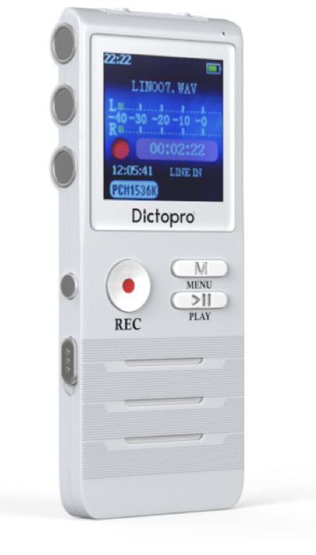
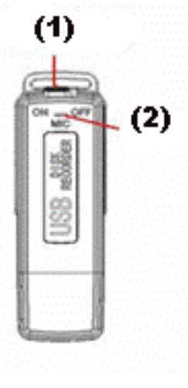
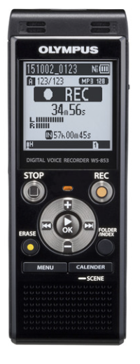
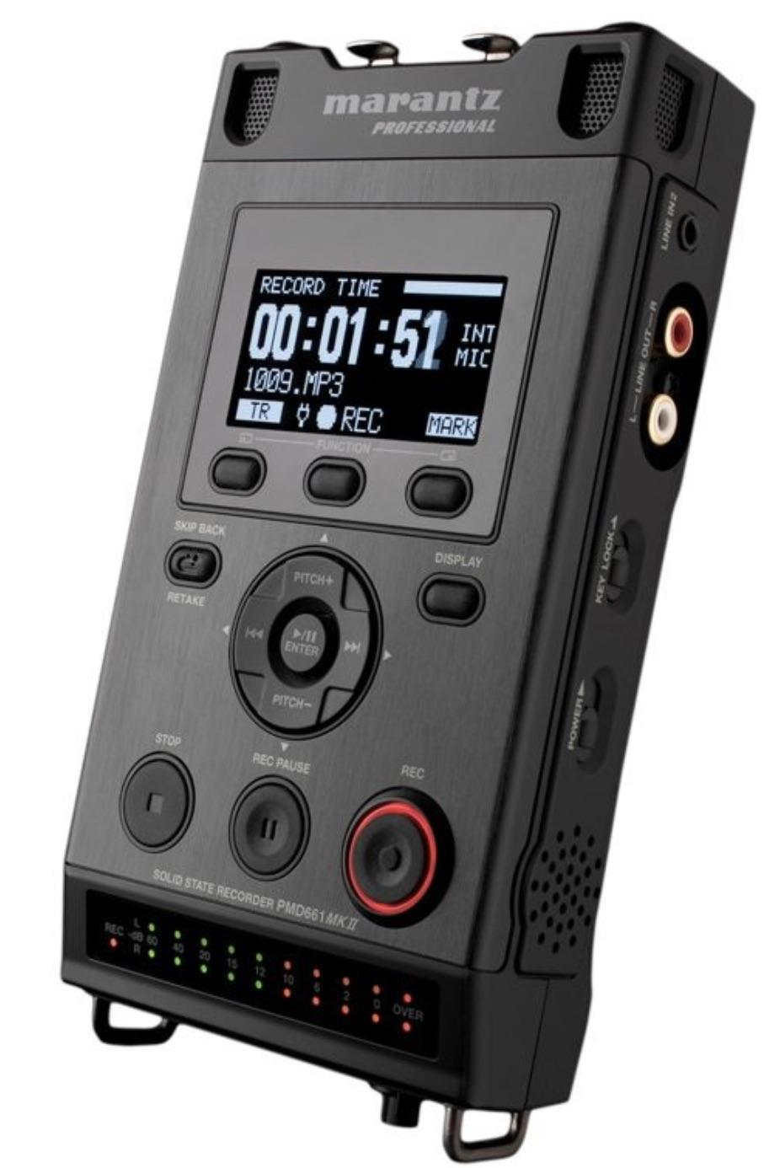

Slide 6
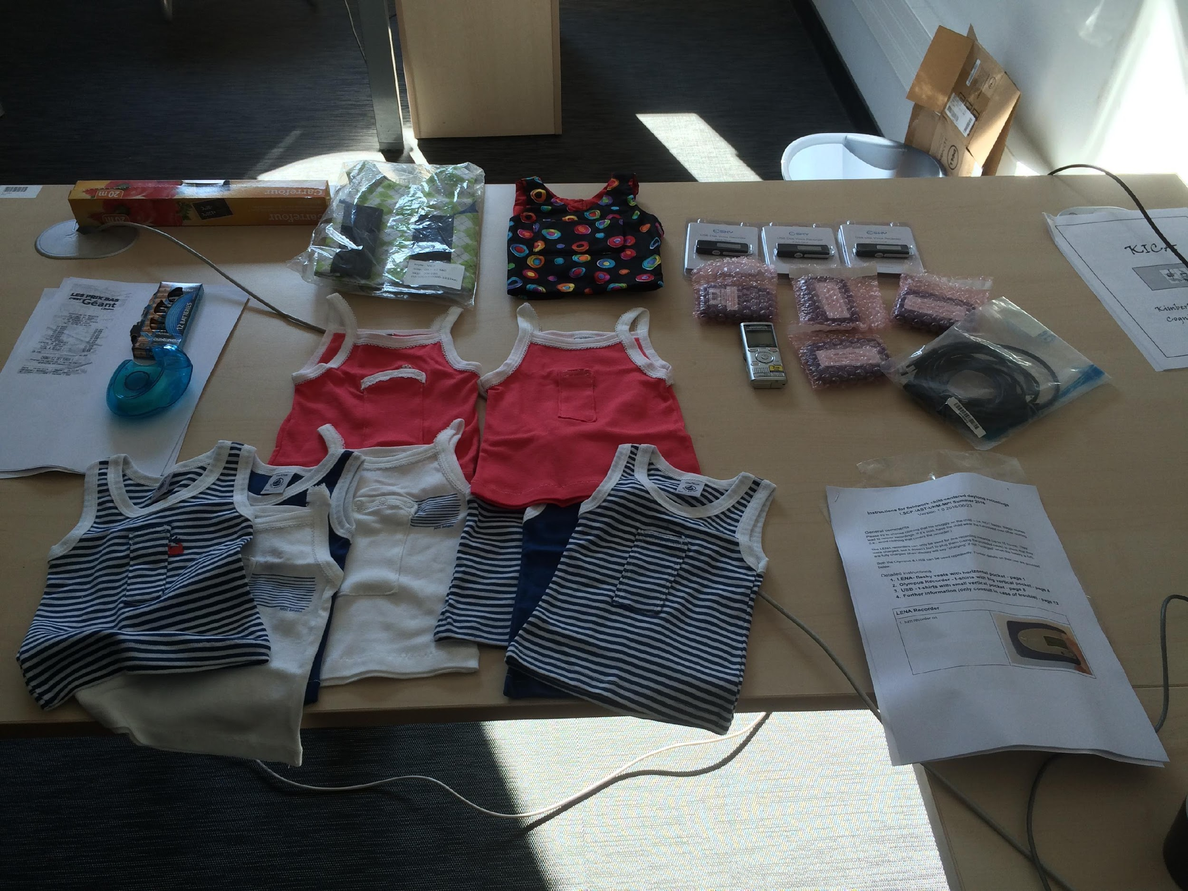
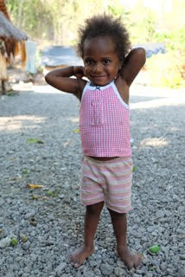
Olympus – 15h – $250
Spy USB– 15h – $20
Photo credit: Heidi Colleran
LENA – 16h – $330, can only be analyzed/audio export with proprietary software (many $1,000s)

Slide 7
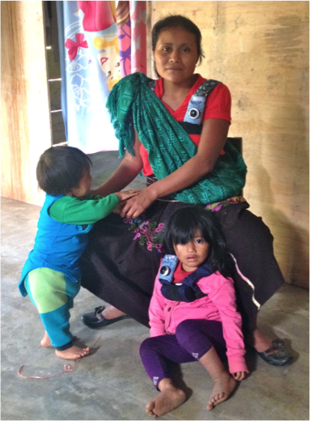
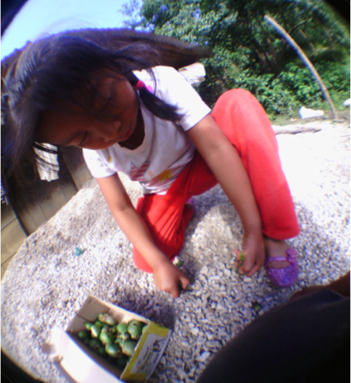
Casillas in progress
Come to her talk on Friday!

Slide 8
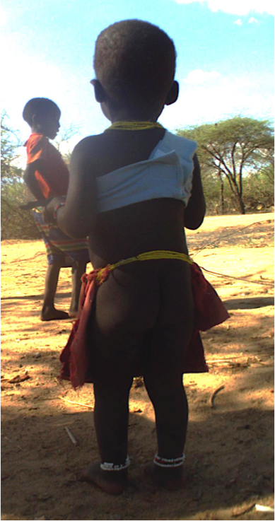
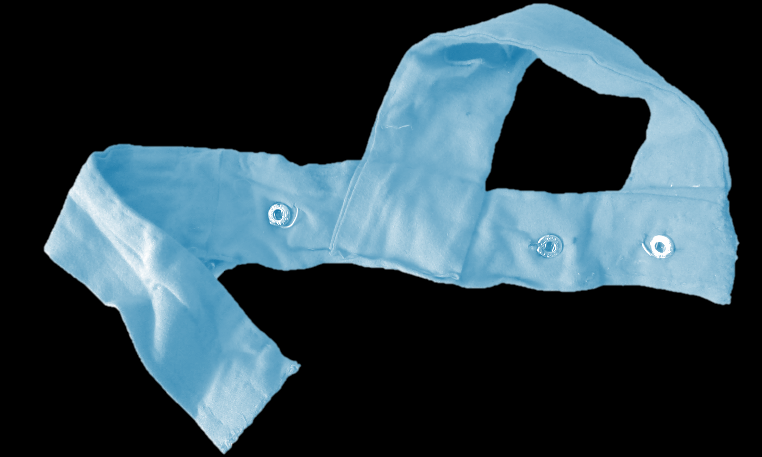
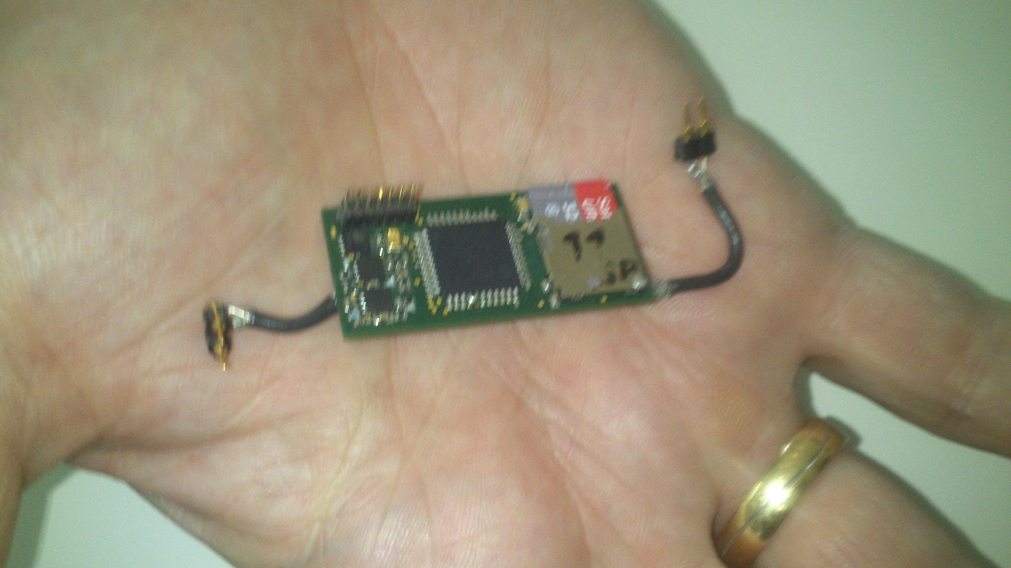
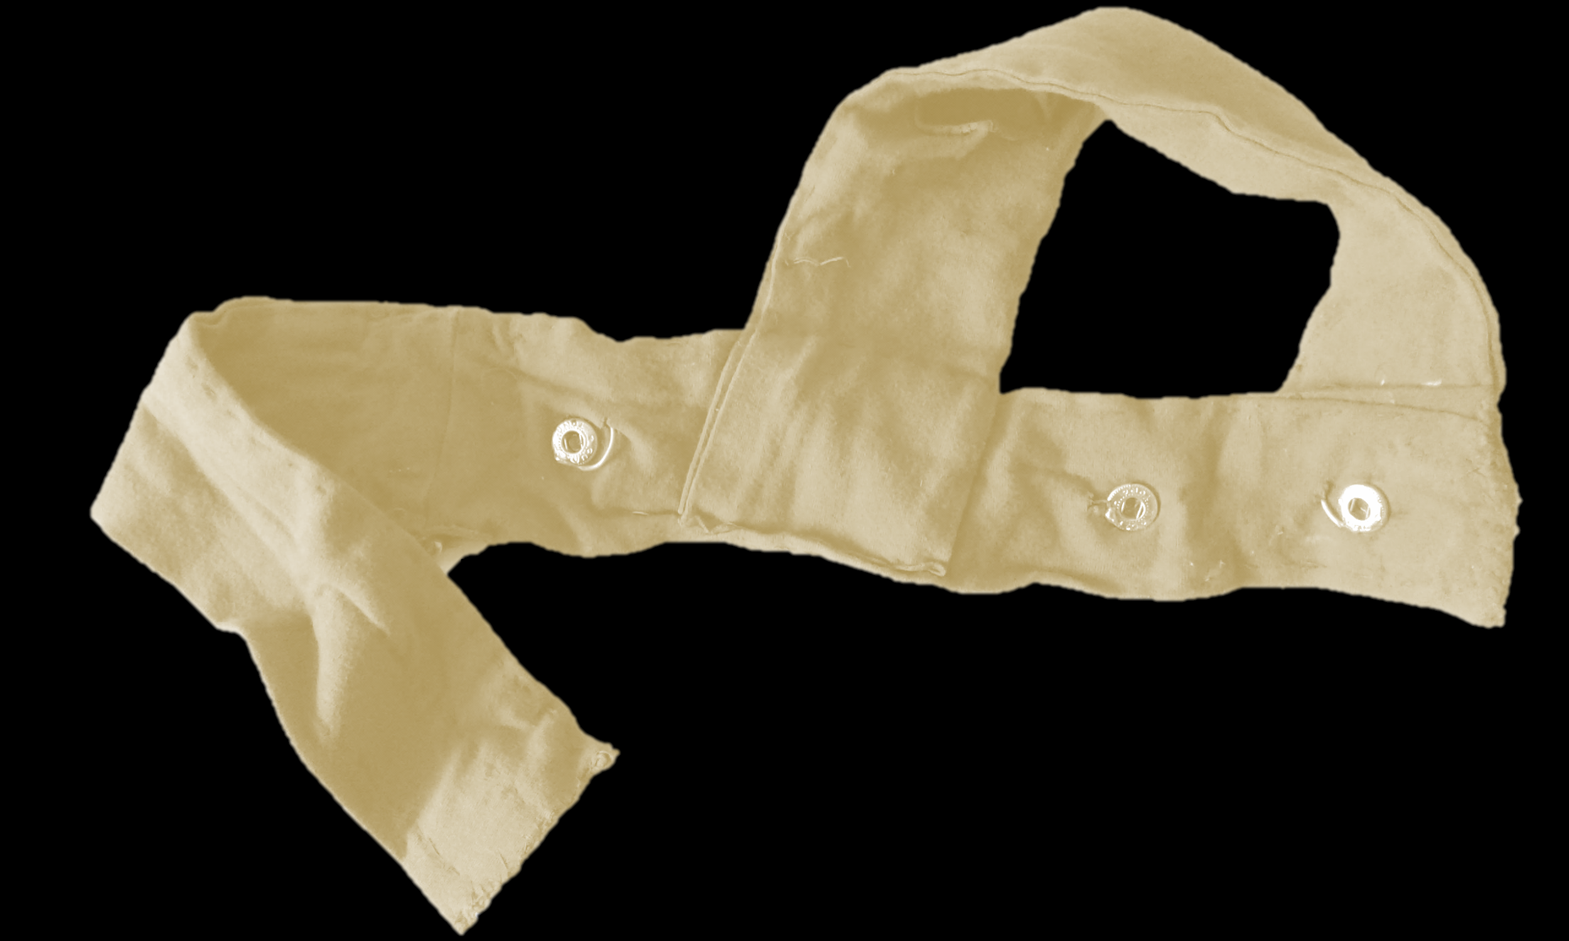
Multimodal Interaction Recorder for Children MIRC (Abels & Abels)
Come to her talk on Friday and you’ll see a nicer version of this slide!

Slide 9
Choosing your software for human annotation
Brian MacWhinney

Slide 10
Alternatives
CLAN (CHAT) 4 transcribing modes (waveform, transcriber, sound walker, edit)
Export to CSV, R, etc., database support from MTAS
ELAN great alignment between tiers
CHAT → ELAN → CHAT works great
Praat great for acoustic analysis, built inside PHON
PHON phonological analysis, works with CLAN and Praat
DataVyu possibly fastest, but no compatibiity yet
MS-Word etc. No pathway to analysis, no linkage to audio
Transcriber good for CA, but not open

Slide 11
Routines for automatized analyses:
Evaluation of LENA software & alternatives
Alex Cristia

Slide 12
Let me crush your hopes.
Other than LENA, there is no off-the-shelf routine that can segment audio into broad speaker classes
Similarly, there is no off-the-shelf routine that can count adult words or give you an estimate of the child’s “linguistic” versus “non-linguistic” vocalization composition
Even in LENA-segmented recordings, some things remain challenging
A lot of the segments are classified as “overlap”
Variable accuracy in broad speaker classification, adult word count, turn count
And some things just do not exist
No current classifier for child-directed versus adult-directed or overheard speech
No current classifier for languages in bilingual samples
Having an automatic transcription is not a feasible goal
And it probably won’t be in the next 10 years either
Notes:
number of days per infant for reliable individual estimations (of X, Y, Z!),

Slide 13
How does LENA work?
Segmentation = acoustic pattern matching on small chunks of the signal
Using ~150 hand-segmented and transcribed hours, built acoustic models for
Target child
Other child
Female adult
Male adult
Overlap
Background categories (TV/electronic, noise…)
Turn counts: adult-child alternation
Adult word counts: regression based on rough # consonants & vowels
Children’s linguistic vs. non-linguistic vocalizations:

Slide 14
LENA: Accuracy talker labels
Agreement across human raters:
Provided 10 continuous minutes (LTR):
Adult vs. non-adult: 88%
Key child vs other child: 91%
Provided 1 continuous hour (Elo): ~85%
Sensitivity: What percentage of segments human calls X machine also calls X?
→ key if algorithm used for selection of segments for further processing
Specificity: What percentage of segments machine calls X human also calls X?
→ key if algorithm used as sole source of information
Notes:
Sensitivity indicates the percentage of human-identified segments that were labeled correctly by the LENA algorithm. Precision refers to the percentage of LENA-labeled segments that were identified with the same label by the human rater.

Slide 15
LENA: Accuracy talker labels
 | Sensitivity |  |  | Specificity
 | LTR5 | Gilk | Elo | vD | Ko+ | Berg | Seidl | Elo | Gilk
Child | 76% | 79% | 90% | 86% | 88% | 60- 70% | 72% | 58% | 21%
OCh |  |  | 86% |  |  |  |  | 94%
FA | 82% | 81% | 83% | 60% | 83% |  | 72% | 95% | 66%
MA |  |  | 91% | 60% |  |  |  | 96%
Berg: Bergelson et al. in prep
Elo: Elo 2016 Finnish twins
Gilk: Gilkerson et al. 2015 Mandarin
Ko: Ko et al. 2015
LTR: LENA Tech Rep #5
vD: vanDam & Silbert 2013
Seidl: Seidl et al. in prep -- ASD risk infants
Sensitivity: What percentage of segments human calls X machine also calls X?
Specificity: What percentage of segments machine calls X human also calls X?
In red if below 75%
Notes:
Sensitivity indicates the percentage of human-identified segments that were labeled correctly by the LENA algorithm. Precision refers to the percentage of LENA-labeled segments that were identified with the same label by the human rater.

Slide 16
LENA: Accuracy talker labels
Take home messages:
Sensitivity not much worse than human coders (who are provided with a lot more info!)
Specificity extremely variable across studies
In few cases perfect → must consider, how will that level of noise impact your conclusions?
Notes:
Sensitivity indicates the percentage of human-identified segments that were labeled correctly by the LENA algorithm. Precision refers to the percentage of LENA-labeled segments that were identified with the same label by the human rater.

Slide 17
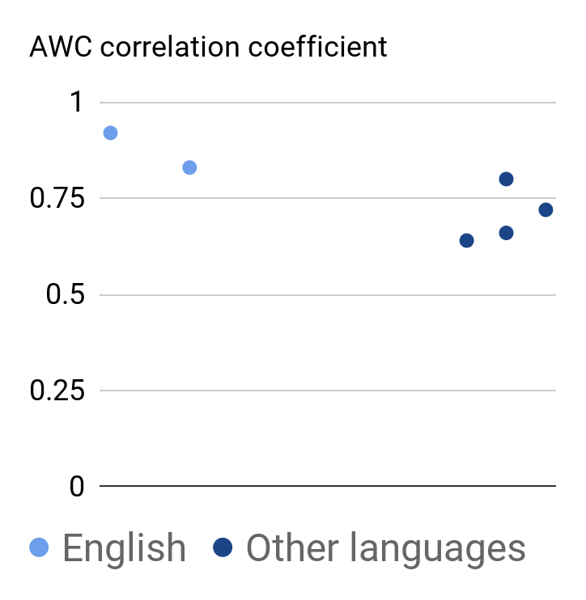
Soderstrom & Wittebolle 2013
Weisleder & Fernald 2013 Spanish
Canault et al. 2015 French
Corinna-Schwartz et al. 2017 Swedish
Gilkerson et al. 1015 Mandarin
LTR: LENA Tech Rep #5
See also (for error estimates):
Elo 2016 Finnish
Gilkerson et al. 1015 Mandarin
Van Alphen et al. 2017 Dutch
Take home message: LENA is a good input pedometer (under constant noise conditions, test may be biased)
Notes:
LTR
0.92
S&W13
0.83
W&F13
0.8
C+15
0.64
G15
0.99
C17
0.66

Slide 18
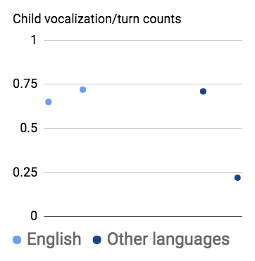
Soderstrom & Wittebolle 2013
Canault et al. 2015 French
Gilkerson et al. 1015 Mandarin
LTR: LENA Tech Rep #5
See also (for error estimates):
Elo 2016 Finnish
Take home message: LENA is a somewhat messy output pedometer (under constant noise conditions, test may be biased)
Notes:
CVC overall correlation r=.688, (daycare r=.716, home r=.646) (Soderstrom & Wittebolle, 2013)

Slide 19
LENA: Other evaluations
Little work evaluating accuracy of:
Segmentation
Linguistic-ness child vocalizations:
LTR5 linguistic: 75%, non-linguistic: 84%
Similarly good estimates for Mandarin (Gilkerson et al., 2015) and Finnish (Elo, 2016)
Global evaluations:
E.g., predictive value of LENA-derived measures & standardized language measures (though see LTR)
Notes:
Overall, these segments included 54% speech- related and 46% nonspeech sounds. We observed good sensitivity (speech: 84%; nonspeech: 70%) and precision (speech: 77%; nonspeech: 78%), comparable to that found for AE (Xu et al., 2009).

Slide 20
Using LENA output as a jumping off point
Starting with LENA output, and “fixing” segmentation
Export to Praat, ELAN, CLAN, etc.
Not clear this is faster that starting from scratch
Taking LENA segmentation at face value, then post-process by hand as appropriate
Use LENA output to find “high volubility” regions (vanDam, Bergelson, …)
IDS-Label project

Slide 21
Example: CDS/ADS project
61 families (from 4 corpora)
LENA output to find 20 conversational blocks with at least 10 MAN/FAN turns
Output used again for segmentation:
Block presented to 3 human coders: Asked to label each MAN/FAN turn as
MAN, FAN, or “junk”
CDS, ADS, or “junk” → only majority agreement fed into next step
Human inter-rater agreement good: K > .7
b. Segments presented to machine: Asked to learn CDS/ADS classification from training set, evaluated on test set
Best model’s classification performance (average recall): .7
Notes:
excluding “JUNK” by hand
E.g. IDSlabel project - QUICKLY label FAN/MAN for CDS/ADS - accuracy?
Using LENA conversational blocks as a means of finding/grouping speech
Annotation at the conversational block label (is this conversation CDS or ADS?)
Can combine with LENA measures (e.g. extract AWC)
Using LENA to find regions of interest
E.g. high/low speech volume (see work by Bergelson)

Slide 22
Add-ons to LENA: What is on our github?
Lots of scripts to tally up things
Vocalization quantity as a function of time of day
Augmenting CHN or FAN’s turns
F0 extraction (e.g., vanDam)
(F1-F2 extraction should be feasible!)
Conversational dynamics:
Likelihood of child re-vocalizing (e.g., Anne Warlaumont in perl)
F0 convergence (e.g., Alex Cristia in Praat)

Slide 23
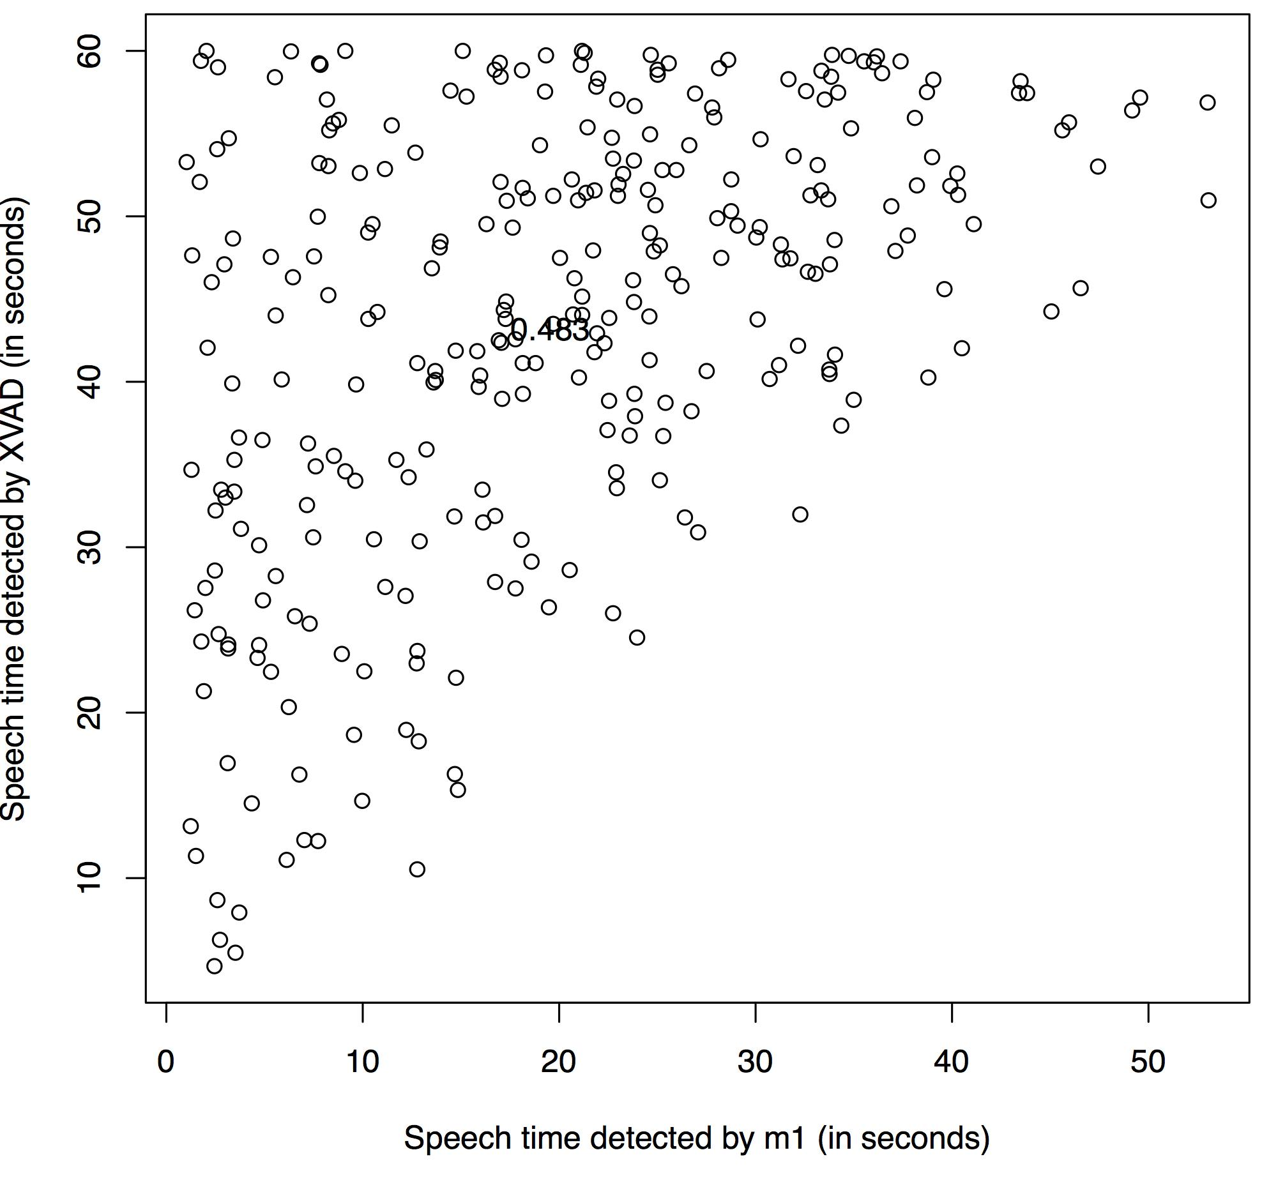
Alternatives to LENA: Voice activity detection
In my lab, we have tried:
Praat voice detector
ELAN voice detector
Python voice activity detection libraries
They all vastly overestimate “voice” (probably, they are “sound detectors”)
None remotely approximate LENA’s performance
None does speaker classification
Machine
Human

Slide 24
Alternatives to LENA: Broad speaker diarization
Fan’s student project, directed by Metze - 2016
Based on subset of vanDam public corpus
Human annotation of “talker turn”
High volubility 5 minute segment from several days→ total of 7h
Those were transcribed from scratch (without lena algo info), in CLAN
Overlapping segments were individually tagged
Approach 1: Kaldi recipe
CHI/MOT/FAT, f-scores around .7-.8; for Other adult and child, about .5
Not enough data for balanced test/train
Approach 2: Alize
Performance worse than previous one
Hot off the press! Rajat Kulshre @ CMU trying to do approach 3
Overall, issue is that vanDam corpus not tagged for speech detectors (silences not always tagged)
Notes:
Issues:
Not enough data, and some issues with annotations: the 5-minute well-annotated files are not labeled for silence (so we don't know the exact portion inside each segment where speech happened, we only know who spoke there).
- Do you think the .7 score with the initial kaldi pipeline could
reflect overfitting to that dataset, or do you think it's a fair
performance test?
Looking back at the report that Fan's group submitted last year, they tested their final model on a held-out test set. The F1 score for each category on this test set is lower than the crossvalidation scores, but not by a significant amount. They could have generalized better with more data, but I think they still did a fair job. Also, the F1 for CHI and FAT is around 0.7, but for other categories it is lower (in part because of clubbing multiple speakers into OCH and OAD categories).
- Was the second pipeline better or worse or not finished and I should
remove it?
The second pipeline had much worse scores. I believe they focused a lot more on the first pipeline so there might be scope for improvement here. I think an important limitation was that the ground truth annotation doesn't contain silence markings.

Slide 25
What will it take to match LENA performance?
LENA Foundation did a good job feeding their algorithms
Age- & SES-varied sample: 329 children, aged 0-4
All recorded with the same setup (minimal variations in recording device, clothing)
Training set: 309 x 30’, Test: 70 x 10’
But LENA’s algorithms are old
Today, many much better alternatives
A new algorithm would also allow parametrization for specific languages
Bottleneck to match them:
Not enough human-segmented and labeled data from which to train the systems
Samples not representative of the range of ages, recording conditions, etc etc, that our recorders

Slide 26
What will it take to match LENA performance?
LENA Foundation did a good job feeding their algorithms
Age- & SES-varied sample: 329 children, aged 0-4
All recorded with the same setup (minimal variations in recording device, clothing)
Training set: 309 x 30’, Test: 70 x 10’
But LENA’s algorithms are old
Today, many much better alternatives
A new algorithm would also allow parametrization for specific languages
Bottleneck to match them:
Not enough human-segmented and labeled data from which to train the systems
Samples not representative of the range of ages, recording conditions, etc etc, that our recorders
We need to share back!!

Slide 27
Data Collection & sampling issues
Melanie Soderstrom
(With thanks to the DARCLE and ACLEW groups)

Slide 28
When/how/what to record
Mail-in vs. Drop-off
Less control over hardware useage
Recruitment/retention pros and cons - range vs. compliance
Do you want to get the whole day?
Do you suspect there will be night time activity that you want to capture? Many of the recorders discussed go up to 10-16h but not 24h...
Do you want to get a “typical” day (weekdays, weekends)?
Consent issues with daycares….
Do you want to get a “representative” day?
E.g. is seasonal variation in activity an issue?
Clothing problems in the winter
Suggestions for other data that would help interpret audio
Have parents log activities & people present - pros and cons
Collect snapshots with a life-logging device
Collect audio samples of key people (e.g., adults read out a short consent form → “vocal signatures”)

Slide 29
Cleaning up the data
Naptime
LENA: check for silence
Others: use Audacity or Praat to detect loudness & silence
Human checking to confirm
Caution: excluding naptime may challenge cross-cultural comparisons
Other quality issues
Outdoor clothing in the winter
Recorder removed from child (bathtime, car ride, non-compliance etc.)
Recording pauses, other technical issues

Slide 30
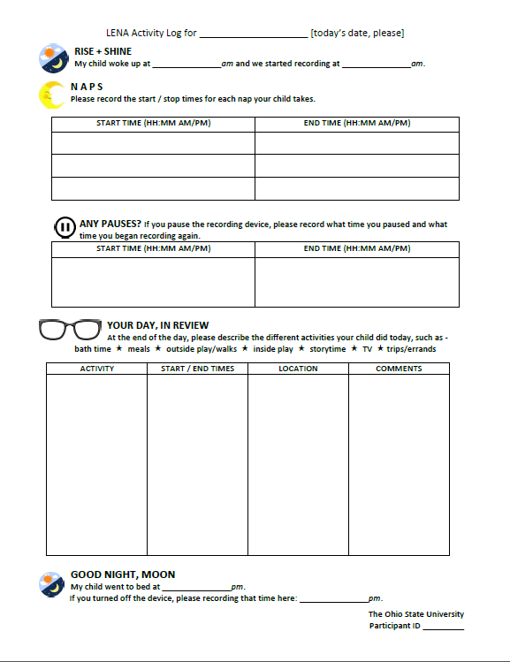
Log Sheets
Thank you to Derek Houston and Jessa Reed at OSU

Slide 31
Subsampling for human annotation
SUBSAMPLING IS UNAVOIDABLE:
Toy example: 20 kids x 1 daylong recording (16h) = 320 raw hours
Broad speaker diarization x 3 playback time = 960h
Transcription & deeper annotation x 10 playback time = 3200h
~ 1.5 years working 40h per week
And that is without considering time for ensuring appropriate formatting of transcription, training other people to do it, a second pass of 5-10% for reliability, etc!
Real example: Seedlings dataset
44 kids x 12 daylong recordings = 8448 raw hours
Broad speaker diarization: 25,344h→ 12 years working 40h per week
Transcription: 84,480h → 41 years working 40h per week
Real example #2: Winnipeg corpus
15 minutes per recording
8+ years running with a posse of transcribers and still working on it.

Slide 32
Reasonable sampling schemes
Goal: represent diversity in activities and/or time of day to describe population (collapse across children)
Sample 1 minute/h
Goal: compare across children (individual variation)
Sample at mealtime (provided no cultural variation in “role of talk in mealtime” within your sample)
Use parental log or human who checks audio at around lunchtime
Goal: describe input, output, or interactions
Focus on regions of high adult input
Focus on high child output
Focus on chunks with high number of conversational turns
These are currently possible only with LENA!

Slide 33
Annotation: why determines how
Is the human annotation your sole source of data?
If so, your usual considerations apply (i.e., however much data you’d want from any other recording method)
The rest of the slide assumes no: You are annotating in order to feed into and evaluate automatized analyses
How to annotate:
Goal is to feed into analyses, e.g. develop acoustic models
→ Provide humans as much information as is needed for them to be reliable
Goal is to evaluate whether a given automatic system can do job X:
→ the human & the machine should have access to the SAME information (e.g., pull segment out of context if the machine is not using context)
E.g., some things may not be machine-discoverable: Broad classifications applying to large chunks of time (e.g., “mostly English/CDS” for a 5-minute chunk)

Slide 34
Why use the DAS?
Marisa Casillas (and the DARCLE group)

Slide 35
Sharing annotations (usefully)
Interoperable structure
Usability across multiple common platforms
Fit for daylong recordings
Not transcription-centric and suited for sparse annotation within a longer file
Oriented toward automation
Suggested (customizable) annotation types that tie into the development of automated annotation tools
Designed for individual and community use
Highly flexible template-based annotation structure with a forum for sharing both general and project-specific templates
Notes:
Interoperable annotation formats are fundamental to the utility, expansion, and sustainability of collective data repositories. In the study of language development, shared annotation schemes have been critical to facilitating the transition from raw acoustic data to searchable, structured inventories (e.g., what CHAT does for CHILDES).
Current schemes, like CHAT, typically require annotators to comprehensively and manually annotate recordings for utterance boundaries and orthographic speech content, with an additional, optional range of properties dependent on those. These schemes have been enormously successful for datasets on the scale of dozens of recording hours but are untenable for long-format recording corpora, which routinely contain hundreds or even thousands of hours of audio.
Long-format corpora would benefit greatly from (semi-)automated analyses, both on the earliest steps of annotation—voice activity detection, utterance segmentation, and speaker diarization—as well as later steps—e.g., classification-based codes such as child-vs-adult-directed speech, and speech recognition to produce phonetic/orthographic representations.
The DARCLE annotation scheme (DAS) is an annotation workflow specifically designed for long-format corpora which can be tailored by individual researchers and which interfaces with the current dominant scheme for short-format recordings. The workflow allows semi-automated annotation and analyses at higher linguistic levels. We give one example of how the workflow has been successfully implemented in a large cross-database project.

Slide 36
The DARCLE Annotation Scheme (DAS)
https://osf.io/4532e/wiki/home/
Interoperable structure
Usability across multiple common platforms
Fit for daylong recordings
Not transcription-centric and suited for sparse annotation within a longer file
Oriented toward automation
Suggested (customizable) annotation types that tie into the development of automated annotation tools
Designed for individual and community use
Highly flexible template-based annotation structure with a forum for sharing both general and project-specific templates
Notes:
Interoperable annotation formats are fundamental to the utility, expansion, and sustainability of collective data repositories. In the study of language development, shared annotation schemes have been critical to facilitating the transition from raw acoustic data to searchable, structured inventories (e.g., what CHAT does for CHILDES).
Current schemes, like CHAT, typically require annotators to comprehensively and manually annotate recordings for utterance boundaries and orthographic speech content, with an additional, optional range of properties dependent on those. These schemes have been enormously successful for datasets on the scale of dozens of recording hours but are untenable for long-format recording corpora, which routinely contain hundreds or even thousands of hours of audio.
Long-format corpora would benefit greatly from (semi-)automated analyses, both on the earliest steps of annotation—voice activity detection, utterance segmentation, and speaker diarization—as well as later steps—e.g., classification-based codes such as child-vs-adult-directed speech, and speech recognition to produce phonetic/orthographic representations.
The DARCLE annotation scheme (DAS) is an annotation workflow specifically designed for long-format corpora which can be tailored by individual researchers and which interfaces with the current dominant scheme for short-format recordings. The workflow allows semi-automated annotation and analyses at higher linguistic levels. We give one example of how the workflow has been successfully implemented in a large cross-database project.

Slide 37
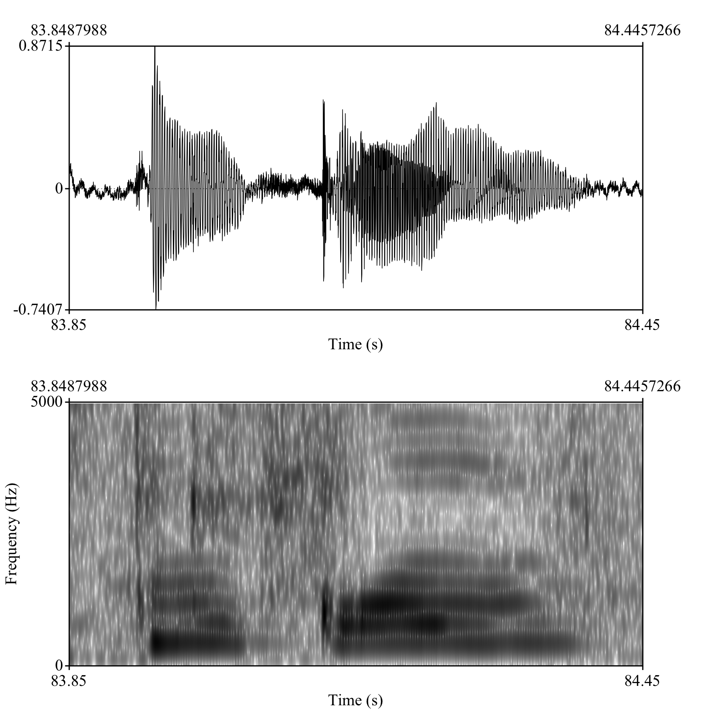
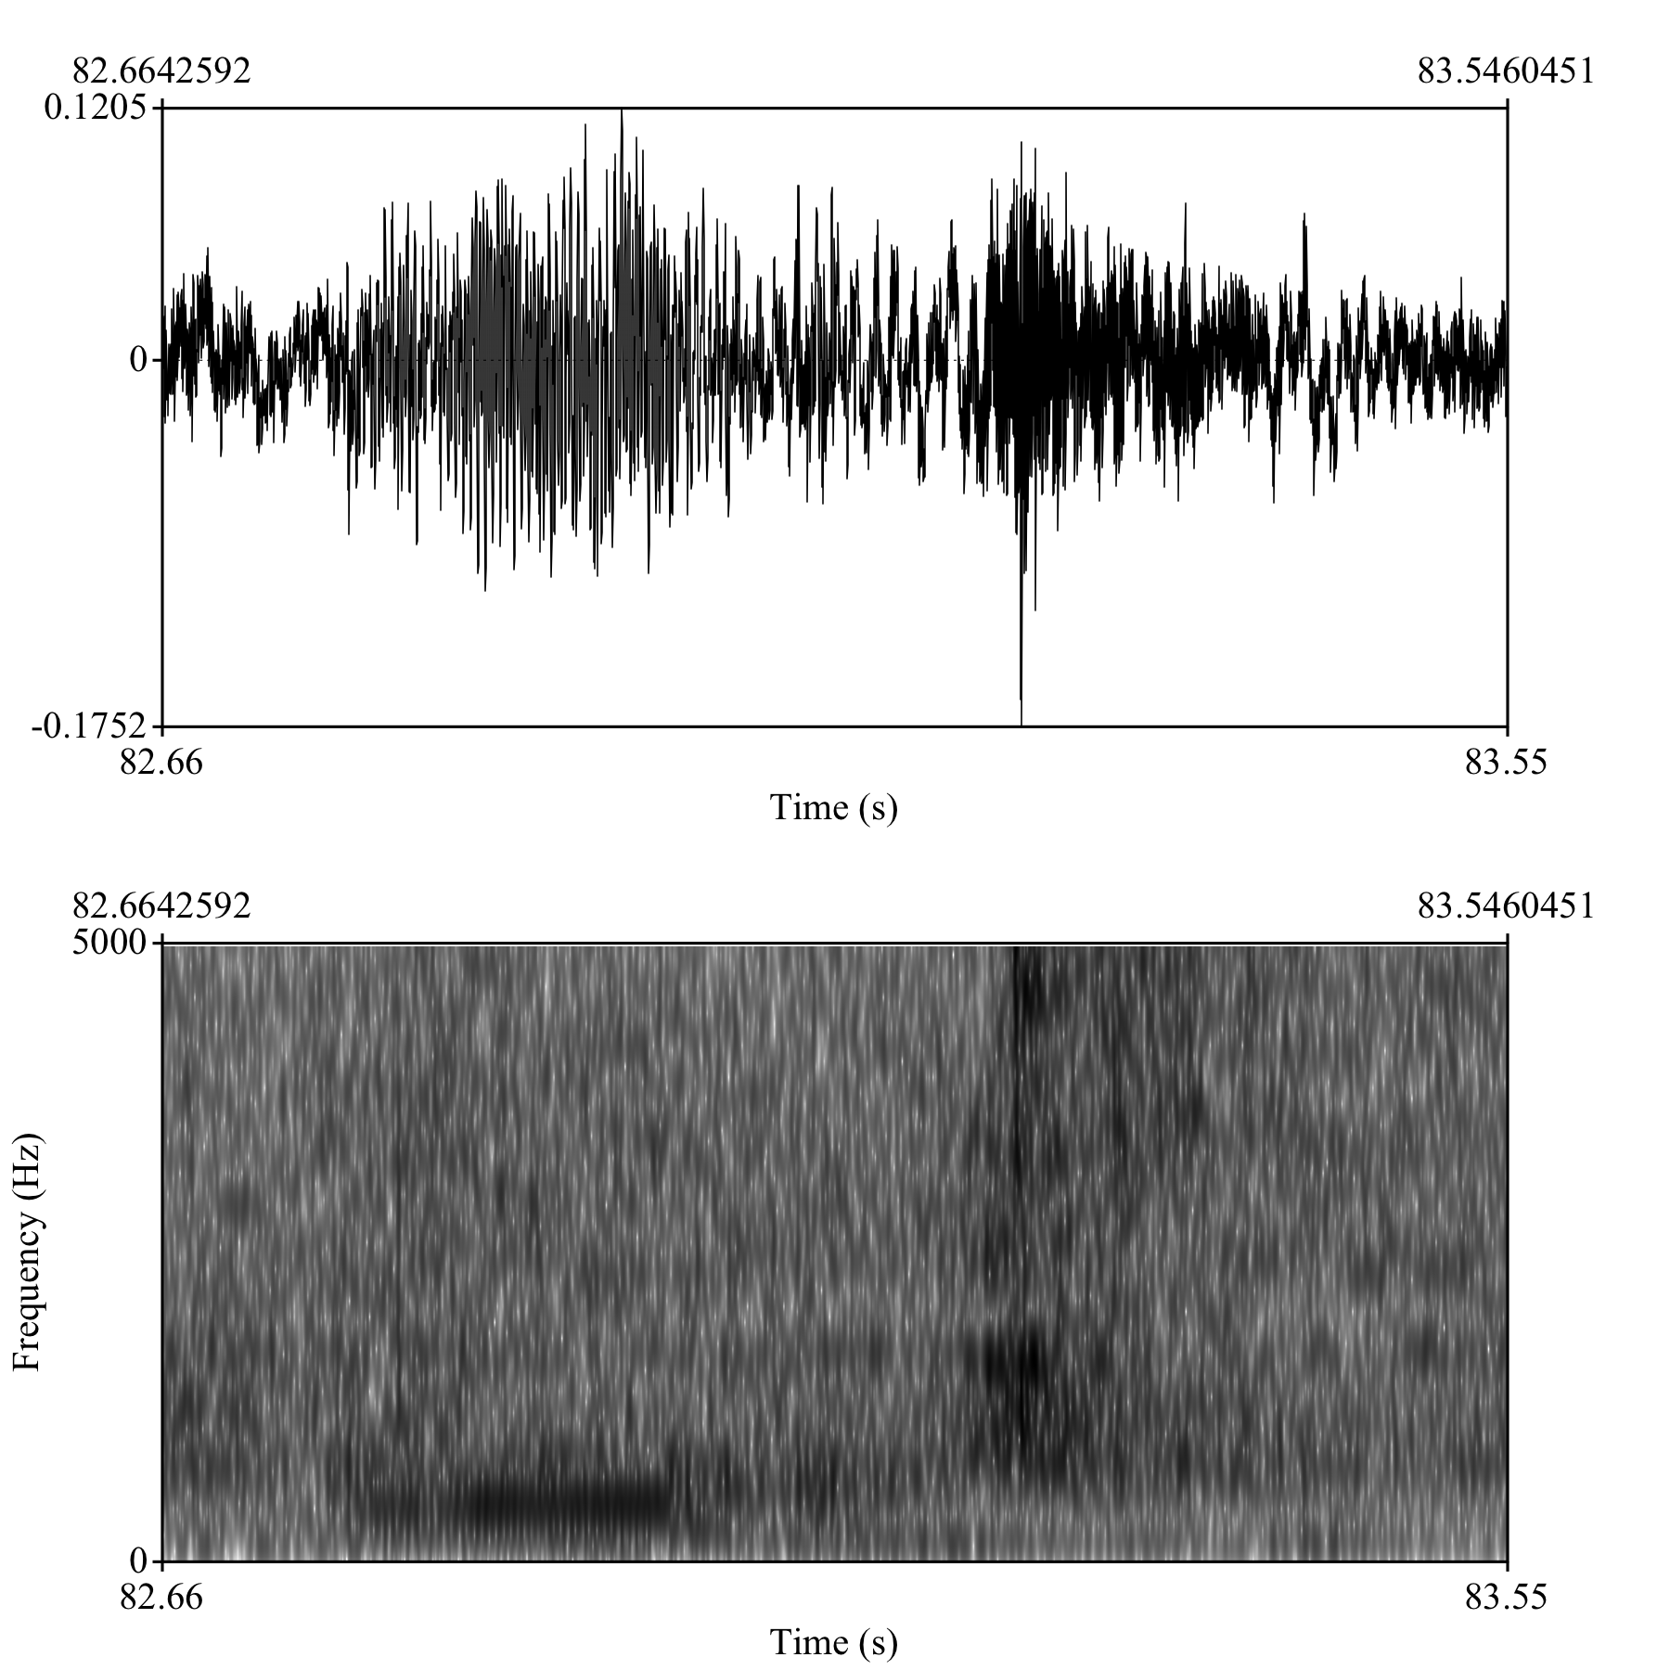
First recording day
CHI
Female
1;02.03
MOT
29;00.00
Some university
Hispanic
Central California
Addressee
A = 1+ adult addressees only
C = 1+ child addressees only
B = 1+ adult and 1+ child addressees
P = animal/pet addressee
O = other addressee
U = unsure
Transcription
<text field>
Utterance boundaries
Canonical babble?
Individual speaker tiers
Hierarchical annotations
Lexical?
[STOP]
Closed vocabularies
Multi-word?
Metadata storage
… all with maximum flexibility
Notes:
What do we have in common?
Let’s just start with audio (applies to most people looking at children acquiring spoken languages)

Slide 38
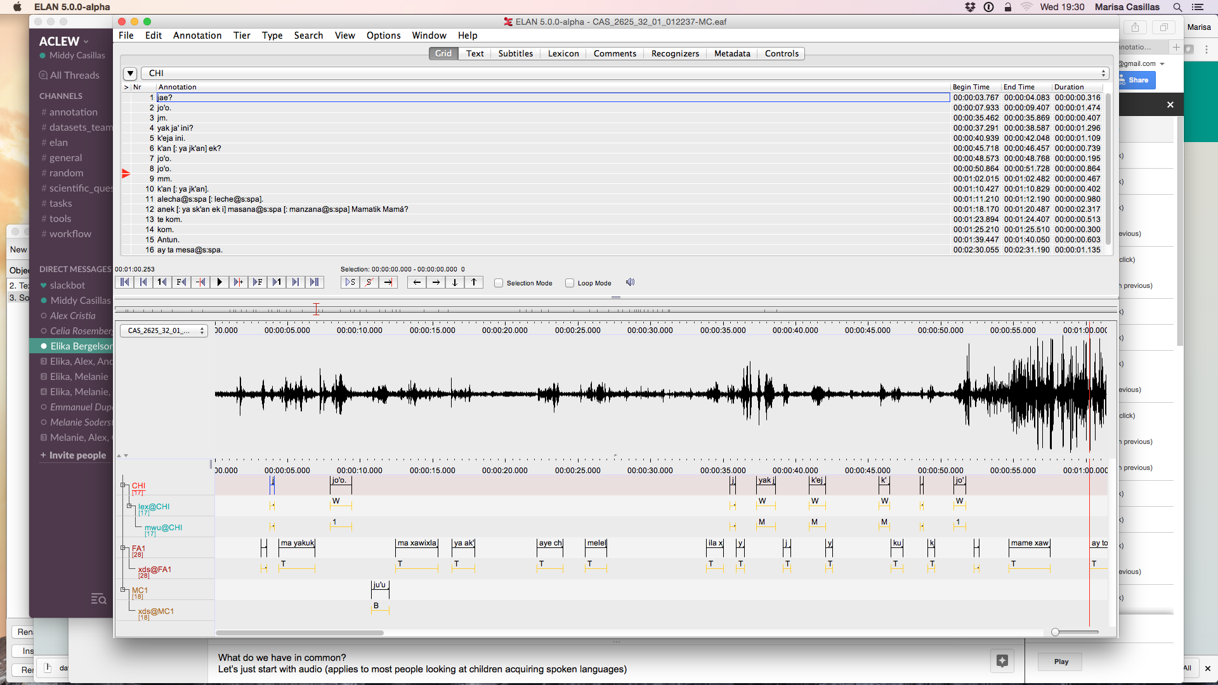
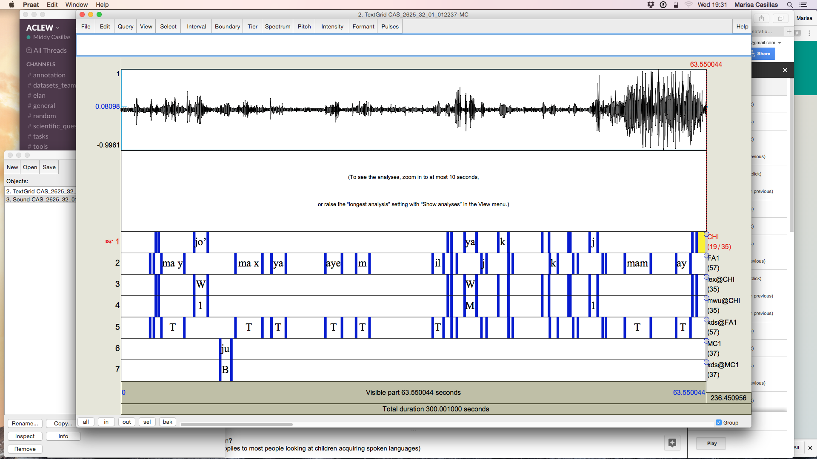

Slide 39
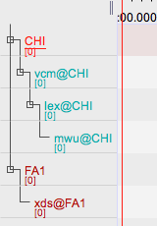
ELAN
Utterance boundaries
Individual speaker tiers
Hierarchical annotations
Closed vocabularies
Metadata storage
(Mostly) interoperable
Notes:
You don’t have to start in ELAN—you could start in Praat, CLAN, or other software as alternatives for first pass.

Slide 40
Templates: minimal and customized

Slide 41
Templates: minimal and customized

Slide 43
The DARCLE Annotation Scheme (DAS)
https://osf.io/4532e/wiki/home/
Interoperable structure
Usability across multiple common platforms
Fit for daylong recordings
Not transcription-centric and suited for sparse annotation within a longer file
Oriented toward automation
Suggested (customizable) annotation types that tie into the development of automated annotation tools
Designed for individual and community use
Highly flexible template-based annotation structure with a forum for sharing both general and project-specific templates

Slide 44
The DARCLE Annotation Scheme (DAS)
https://osf.io/4532e/wiki/home/
Interoperable structure
Usability across multiple common platforms
Fit for daylong recordings
Not transcription-centric and suited for sparse annotation within a longer file
Oriented toward automation
Suggested (customizable) annotation types that tie into the development of automated annotation tools
Designed for individual and community use
Highly flexible template-based annotation structure with a forum for sharing both general and project-specific templates

Slide 45
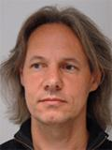
Area experts
DARCLE group
ACLEW group (tools people)
OSF
GitHub

Slide 46
Why use the DAS?
Help us build an annotation infrastructure designed for the future.
Help us help you!

Slide 47
Break out sessions
You can approach:
Brian, Melanie, or Alex, if you want to become a HB member through the speedy option (5 minutes!)
For other topics:
Melanie, Brian, & Middy for tips on donating your own corpus
Middy & Alex for non-English & bilingual recordings
Middy for multimodal captures
Melanie for ethics issues
Or you can work by yourself on the following materials...

Slide 48
Teach yourself
Get acquainted with TalkBank
Listening on the browser
Searches on the browser
More powerful CLAN searches
More TalkBank Screencasts
Download HB public data
Through point & click (using a browser) → see slides 18-21 in “Using HB”
Through wget (command line) → instructions here
Start using the DAS
Download HB tools
Through point & click (using a browser) → see slides 22-28 in “Using HB”
Using github
Super short guide to github: you just need the clone command
Using one of the scripts on the HBCode
See for instance this perl script
Contributing your code back
Email us the github address for the repository you want us to add back
Don’t have a github repo address? You should!
Terminal users: Start 3h Software Carpentry Git course
Others: use github desktop, an app that allows you to github without using a terminal!

Slide 49
Thanks!

